Slide 1
Processes in C – Lab. 9
Faculty of Mathematics and Computer Science

Slide 2

Importance of Programming Language
Why C matters:
Powers operating systems like Windows, Linux, MacOS, and Android;
Used in databases (MySQL, SQLite), compilers, interpreters, and 3D software;
Key language for embedded systems and performance-critical applications;
📌
Key features:
Simple, fast, and efficient;
Offers direct hardware manipulation;
Supports modular and structured programming;
📌
Benefits of Learning C:
Strong foundation for understanding modern languages (e.g., Python, Java, C++);
Ideal for low-level system programming;
Teaches how to manage memory and optimize performance;
📌
Notes:
EN:
C is a small and simple language to learn – it only has 32 keywords.
C continues to thrive because of its unmatched speed, portability, and low-level control, making it essential in areas where performance and efficiency are critical.
C is designed for interacting with large software systems.
C remained a simple and small language that packs a lot of power in its raw performance.
C maps directly with assembly in a way that assembly maps to machine code. C achieved a sufficient level of abstraction to improve productivity and communicate concepts in a higher-level language. Because of this C is known as a mid-level language.
Where C is used in industry:
In Microsoft Windows: The kernel and utilities are written in C, C++, and C#, with some parts in assembly.
In Linux: The kernel is entirely written in C (Linus Torvalds considers C the only suitable choice).
Android: Built on top of the Linux kernel → uses the C language.
Databases: Oracle and MySQL are written in C for efficient memory management.
3D Graphics: Complex scene rendering requires performance – provided by C.
And for Embedded systems, C is preferred for its efficiency and low-level control.

Slide 3
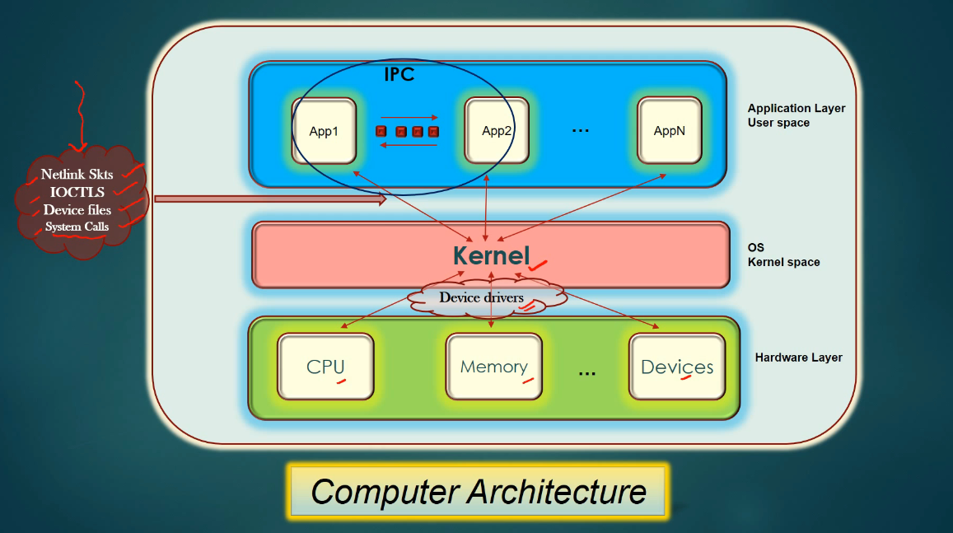
What is IPC and why do we need it?
Notes:
The architecture is divided into 3 main layers:
Hardware Layer
Contains physical components: CPU, memory (RAM/disks), and devices (USB, keyboard, mouse, etc.).
Kernel Space (Operating System Layer)
The kernel runs here, managing hardware resources.
Communicates with hardware using device drivers.
Device drivers are specific programs that teach the kernel how to interact with each hardware component.
User/Application Layer
All user-launched apps run here: Chrome, Office, games, etc.
Applications interact with the kernel using:
System calls
Device files
IOCTLs
Netlink sockets
How do apps talk to each other?
Applications in user space communicate through IPC (Inter Process Communication).
Examples: pipes, message queues, shared memory, semaphores.
Conclusion:
What I want to make it clear here is the fact that we have a structured architecture that ensures safe and organized communication. The kernel acts as a smart mediator between hardware and applications, while IPC allows cooperation between applications.

Slide 4
What is a process in C?
In Linux, a process is a running instance of a program. When you run any application, the operating system creates a process for that program;
A process will contain:
PID: Process ID
PPID: Parent Process ID
UID: User ID
GID: Group ID
Own memory
File descriptors
Every process has a parent process which acts as a task manager;
The parent is entrusted with responsibility for the child from birth to death;
📌
📌
📌
📌
Notes:
In Linux, a process is an instance of a running program, consisting of one or more threads and associated resources (memory, files, security information). Each process is uniquely identified by a PID (Process ID).
Unix processes are fundamental to the operating system because they allow multiple programs and tasks to run and be managed simultaneously. The operating system allocates the necessary resources for each process and handles their scheduling and synchronization to ensure a safe and efficient execution environment.
Essential characteristics of a Unix process:
Unique PID – a unique identifier that distinguishes each process in the system.
Own address space – includes the program's code, data, and execution stack.
Execution context – stores the current state of the process (registers, program counter, etc.).
Priority – affects how much CPU time the process gets compared to others.
Access to resources – processes can use files, memory, and devices.
Inter-process communication (IPC) – through pipes, semaphores, messages, sockets, etc.
Lifecycle – a process can be created, executed, suspended, resumed, and eventually terminated.

Slide 5
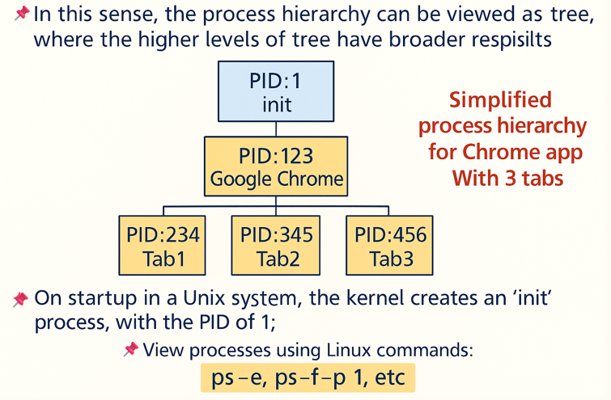
What is a process in C?
Notes:
All processes originate from init or systemd (with PID 1).
This forms a process tree, where each process can create child processes. The parent process is responsible for the processes it creates.
Example:
init (PID 1) is created by the kernel at system startup.
It then starts applications like Google Chrome (PID 123).
Chrome, in turn, creates separate processes for each tab:
Tab1 → PID 234
Tab2 → PID 345
Tab3 → PID 456
This represents a simplified process hierarchy — a tree where Chrome is the parent, and each tab is a child process.
pstree -p: Visualize the hierarchy
The command pstree -p shows parent-child relationships between processes.
Example:
systemd(1) ├─NetworkManager(335) │ └─{NetworkManager}(371) ├─avahi-daemon(270) │ └─avahi-daemon(333) ├─login(707) │ └─bash(931) │ └─pstree(1011)
{NetworkManager}(371) shows a thread running inside the process.
Background processes often have threads, shown in {braces}.
Some processes are subprocesses or clones — for example, avahi-daemon(270) has a child avahi-daemon(333) (for communication).
ps -e: Flat list of running processes
The command:
ps -e
Shows a flat list of all processes running in the system at that moment, with details like:
PID Process ID – uniquely identifies each process
TTY The terminal from which the process was launched
TIME Total CPU time consumed by the process
CMD The name or command of the process
Unlike pstree, ps -e does not show hierarchy, only individual entries.

Slide 6
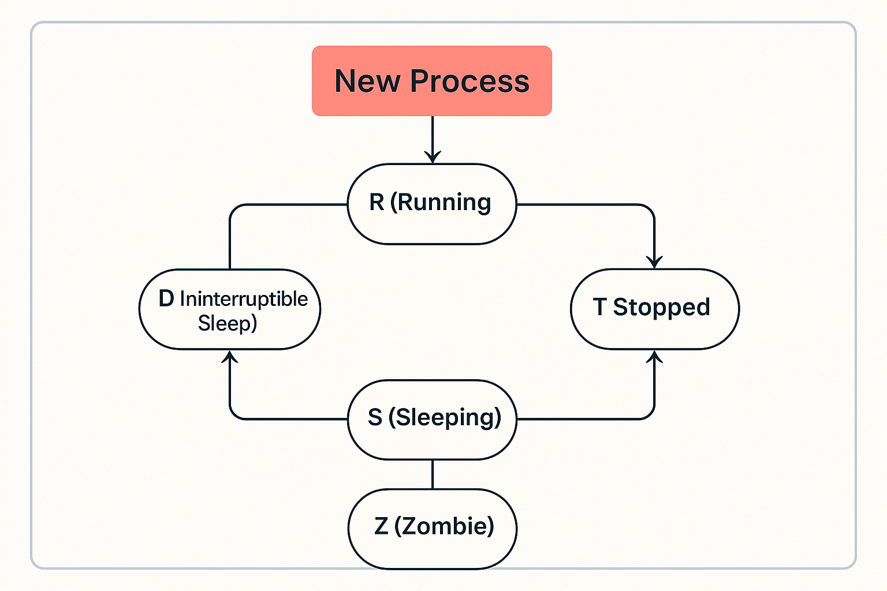
Different stages of a process
Ready
D (Uninterruptible
sleep)
Notes:
Every process goes through several states during its lifetime. These states are shown in the STAT column when using the command ps aux.
Common process states:
CodeStateDescription
R Running The process is actively running or ready to run
S Sleeping The process is waiting for an event (e.g., I/O)
D Uninterruptible
Sleep Waiting on I/O (e.g., disk read) and cannot be interrupted
Stopped The process is paused (e.g., with Ctrl+Z)
Z Zombie The process has finished, but hasn’t been reaped by the parent

Slide 7
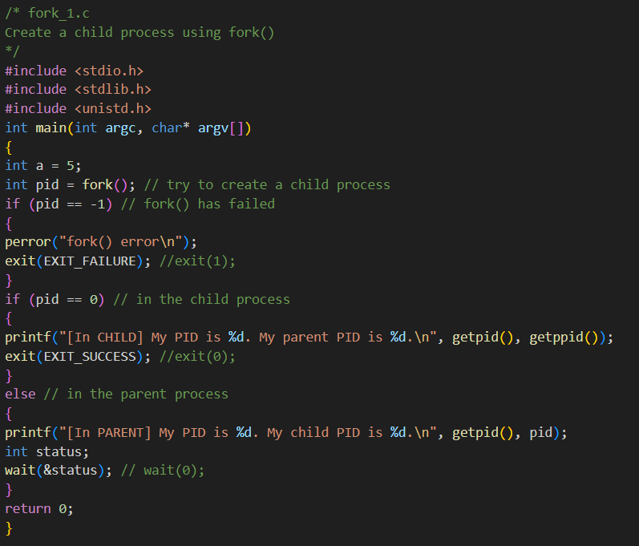
How do I program a Process?
In C, you can create a new process with the fork() command;
📌
Notes:
fork()Creează un nou proces
getpid()Returnează PID-ul procesului current
getppid()Returnează PID-ul părintelui
wait(&status)Așteaptă terminarea copilului
exit()Termină procesul curent
Compile with: gcc fork_1.c -o fork1
fork() is a very interesting command because it is one of the only C commands to return twice — the child process receives a value of 0 from fork, while the parent receives the pid of the child;

Slide 8
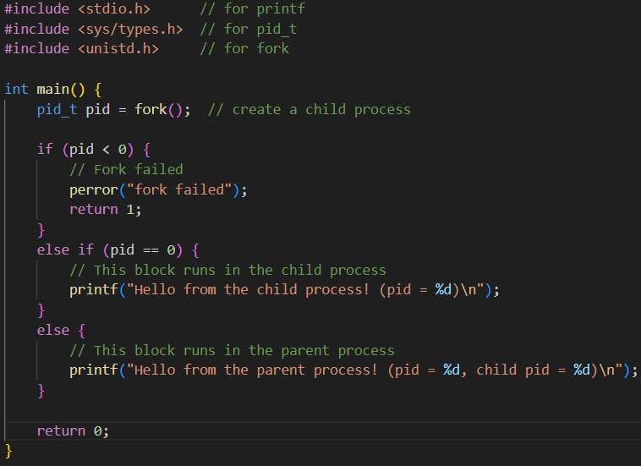
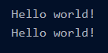
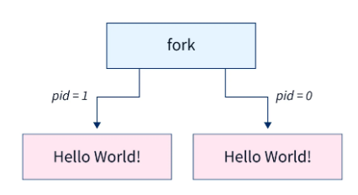
Creating Processes in C
📌
How fork() works : Creates a child process that is an exact copy of the parent.
Parent
Child
! The C fork() function does not have any parameters !
Notes:
fork() este o funcție din C utilizată pentru a crea un nou proces prin duplicarea procesului curent.
Procesul nou creat se numește proces copil și este o copie identică(are acelasi cod) ca si procesul părinte în momentul apelului.
Ambele procese rulează în paralel, dar în spații de memorie diferite
Ptr a folosit fork(), trebuie sa importam libraria unistd.h
:
🔷 Caseta albastră cu text arată că se afișează două mesaje – unul din părinte și unul din copil.
🔶 Diagrama (dreapta jos) explică vizual ce face fork():
După apel, procesul se împarte în două:
Partea părintelui continuă cu pid > 0
Partea copilului începe cu pid == 0
Ambele execută același cod și afișează mesajul "Hello World!"
To use the fork() function, we need to include the unistd.h library:
Forking is the process of creating a duplicate process from an existing process. The duplication process occurs when the C fork() is called. After the forking, there are two types of processes. The first one is the Parent process from which the duplicate processes are formed. The second one is the child process, which is the duplicate process that forms from the parent process.
In the above example, the number of times the C fork() function is used is 1. So the process will be forked in the form of 2 power of n. The value of n represents the number of fork() system calls.
The C fork() function has no parameters, and this function returns an integer value as the returned value. The values returned by the C fork() function are given below.
🔷 Blue output box: shows both messages printed — once by the parent and once by the child.
🔶 Flow diagram (bottom right):
It illustrates how the fork() call splits the execution into two flows:
One continues in the parent (pid > 0)
One starts in the child (pid == 0)
Both processes execute the same code, and both print “Hello world!”

Slide 9
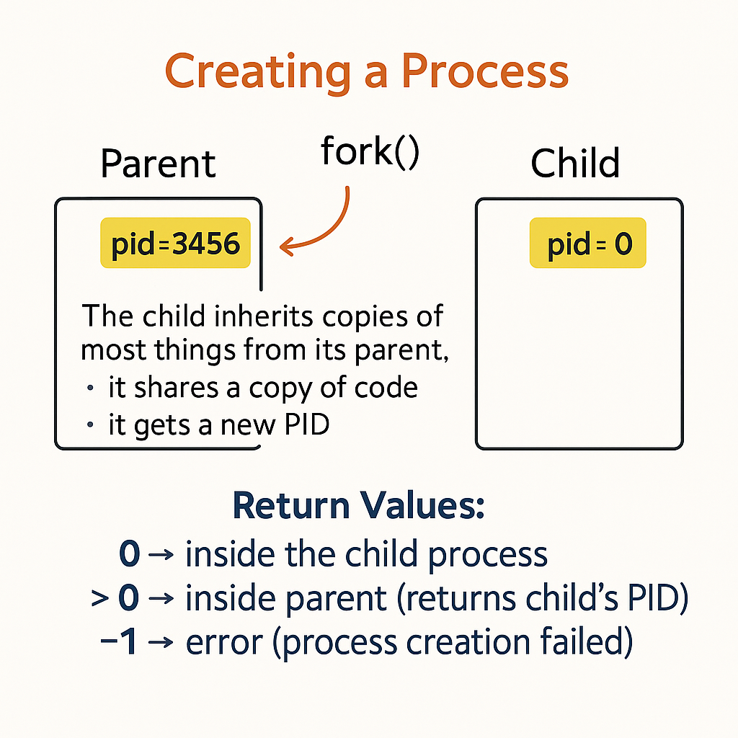
Creating Processes in C
📌
Notes:
Dupa cum spuneam, fork() CREEAZĂ un nou proces:
Dacă fork() returnează -1 → a apărut o eroare
Dacă fork() returnează 0 → suntem în procesul copil
Dacă fork() returnează >0 → suntem în procesul părinte, iar valoarea este PID-ul copilului

Slide 10
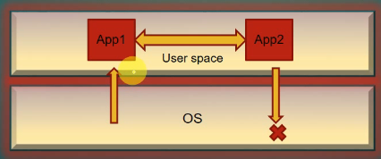
Communication between processes: Signals
A signal is a system message sent from one process to another, not usually used to transfer data;
So signals are used to convey information and prompt processes to take appropriate actions based on the event’s nature;
Therefore, signals have control over processes;
📌
📌
📌
Notes:
The operating system is logically divided into two main parts:
Kernel space – where the operating system itself runs.
User space – where applications like App1 and App2 run.
Applications operate entirely in user space. Signals are used as a communication mechanism in the following ways:
The operating system can send signals to applications running in user space.
One application can send signals to another application within user space.
It is not possible for an application to send a signal to the kernel. There are no such use cases.
This separation is essential to understand how signals work in Linux and to clearly define the roles and responsibilities between user applications and the operating system.

Slide 11
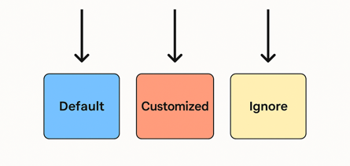
Communication between processes: Handling Signals
When a process receives a signal, either
of the three things can happen:
Process execute the default action of the signal Eg: When process receives SIGTERM signal, process is terminated by default.
Process ignore the signal: SIG_IGN
Process do its customized processing on receiving the signal by executing the signal handler routine. Eg: When process receives the SIGTERM signal, process might want to print the Goodbye msg on screen, or write its internal data structure in a file for offline debugging before it dies out.
Notes:
When a process receives a signal in Linux, one of the following three things can happen:
1. Default behavior
The process performs the default action associated with the signal.
Example: If a process receives SIGTERM, the default action is to terminate the process.
2. Custom signal handling
The process defines a custom function (a signal handler) that is executed when the signal is received.
Example: On receiving SIGTERM, instead of terminating immediately, the process may write a "Goodbye" message to a file or save its current state for debugging.
3. Ignoring the signal
The process explicitly chooses to ignore the signal using signal(SIGTERM, SIG_IGN).
Example: A process may ignore SIGINT (Ctrl+C) if it wants to stay running even when the user tries to interrupt it.

Slide 12
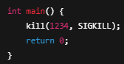

Communication between processes: Sending Signals
We send signals with kill() command to a process or a group of processes:
📌
#include <sys/types.h>
#include <signal.h>
int kill(pid_t pid, int sig);
kill() – pid Argument meaning:
📌
pid value | Meaning
> 0 | Signal is sent to the process with the specified PID
0 | Signal is sent to all processes in the same process group as the sender
-1 | Signal is sent to all processes the sender has permission to signal (except init)
< -1 | Signal is sent to all processes in the group with GID equal to abs(pid)
man 7 signal
Notes:
kill() is a C function that sends a signal to:
a single process
a group of processes
or all processes the user has permission to signal
pid: tells which process or group to send the signal to
sig: tells what signal to send (e.g., SIGTERM, SIGKILL, etc.)
The kill() function does not necessarily "kill" a process – it sends a signal. What the signal does depends on its type and how the target process handles it.
This is a shortcut that sends the SIGKILL signal to process 1234, using the C kill() function behind the scenes.

Slide 13
Signals – SIGTERM, SIGKILL, SIGSTOP, SIGCONT
Common Signals:
📌
Signal | Description
SIGTERM | Graceful termination (can be handled)
SIGKILL | Immediate kill (cannot be handled or ignored)
SIGSTOP | Pause the process (also can't be caught)
SIGCONT | Resume a stopped process
man 7 signal
Notes:
SIGKILL (9) – Immediately terminates a process.
🔒 Cannot be caught, blocked, or ignored.
SIGTERM (15) – Politely asks the process to terminate gracefully.
✅ Can be caught and handled (e.g., to clean up).
SIGSTOP (19) – Pauses (suspends) a process.
🔒 Cannot be caught or ignored.
SIGCONT (18) – Resumes a process that was paused with SIGSTOP.
man 7 signal for full list

Slide 14
Managing Process Priorities
Tools
nice, renice, htop, strace
📌
Process Priorities & Monitoring in Linux
Process priorities are managed using nice and renice
top and htop provide a live process view
strace monitors system calls
Example
Run the following to start a low-priority process:
📌
📌
nice -n 10 sleep 1000
Notes:
Prioritățile proceselor sunt gestionate cu 'nice' și 'renice'. 'top' și 'htop' oferă o vizualizare live. 'strace' monitorizează apelurile de sistem.
Exemplu practic:
Rulează 'nice -n 10 sleep 1000' pentru a porni un proces cu prioritate scăzută.

Slide 15
Practice
Test the exercises from the
examples and examples1 folder;

Slide 16
References
https://linuxhint.com/signal-2-c-function/
https://linuxhint.com/fork_linux_system_call_c/#search/q=signal()
https://medium.com/@razika28/signals-ad83f38f80b6
https://ubbcluj.sharepoint.com/:w:/r/sites/OperatingSystems2024-2025-822/_layouts/15/Doc2.aspx?action=edit&sourcedoc=%7B2acf34dd-bc71-43b6-9aec-d71779eeaef9%7D&wdOrigin=TEAMS-MAGLEV.teams_ns.rwc&wdExp=TEAMS-TREATMENT&wdhostclicktime=1746179367731&web=1
https://www.naukri.com/code360/library/c-fork-function
https://www.scaler.com/topics/c-fork/
http://www.btechsmartclass.com/c_programming/C-Creating-and-Running-C-Program.html#google_vignette
https://aticleworld.com/c-compilation-process/#google_vignette
https://tutorend.com/c/c-compilation-process
https://www.prepbytes.com/blog/c-programming/compilation-process-in-c/
https://cs.brown.edu/courses/csci1310/2020/assign/labs/lab2.html
https://aruneworld.com/programming-language/c/c-compiling-process/
https://www.scaler.com/topics/c/importance-of-c-language/
https://www.scaler.com/topics/features-of-c-language/

